Slide 1
Software Process
Sofware Process
1

Slide 2
Software Process
Process is distinct from product – products are outcomes of executing a process on a project
SW Engg. focuses on process
Premise: Proper processes will help achieve project objectives of high QP
Sofware Process

Slide 3
Software Process…
Process: A particular method, generally involving a number of steps
Software Process: A set of steps, along with ordering constraints on execution, to produce software with desired outcome
Many types of activities performed by diff people in a software project
Better to view software process as comprising of many component processes
Sofware Process

Slide 4
Component Software Processes
Two major processes
  Development – focuses on development and quality steps needed to engineer the software
  Project management – focuses on planning and controlling the development process
Development process is the heart of software process; other processes revolve around it
These are executed by different people
  developers execute engg. Process
  project manager executes the mgmt proces
Sofware Process

Slide 5
Component Processes…
Other processes
  Configuration management process: manages the evolution of artifacts
  Change management process: how changes are incorporated
  Process management process: management of processes themselves
  Inspection process: How inspections are conducted on artifacts
Sofware Process

Slide 6
Process Specification
Process is generally a set of phases
Each phase performs a well defined task and generally produces an output
Intermediate outputs – work products
At top level, typically few phases in a process
How to perform a particular phase – methodologies have been proposed
Sofware Process

Slide 7
ETVX Specification
ETVX approach to specify a step
  Entry criteria: what conditions must be satisfied for initiating this phase
  Task: what is to be done in this phase
  Verification: the checks done on the outputs of this phase
  eXit criteria: when can this phase be considered done successfully
A phase also produces info for mgmt
Sofware Process

Slide 8
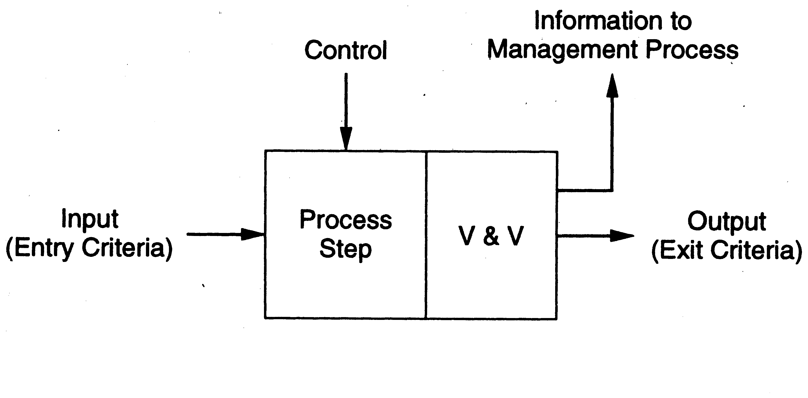
ETVX approach
Sofware Process

Slide 9
Desired Process Properties
Provide high Q&P
  Support testability as testing is the most expensive task; testing can consume 30 to 50% of total development effort
  Support maintainability as maintenance can be more expensive than development; over life up to 80% of total cost
  Remove defects early, as cost of removing defects increases with latency
Sofware Process

Slide 10
High Q&P: Early Defect Removal…
Cost of a defect increases with latency
I.e. fixing a req defect in operation can cost a 100 times the cost of fixing it in requirements itself
Hence, for high Q&P, the process must support early defect removal
That is why there is a V in ETVX, and quality control tasks in the sw process
Sofware Process

Slide 11
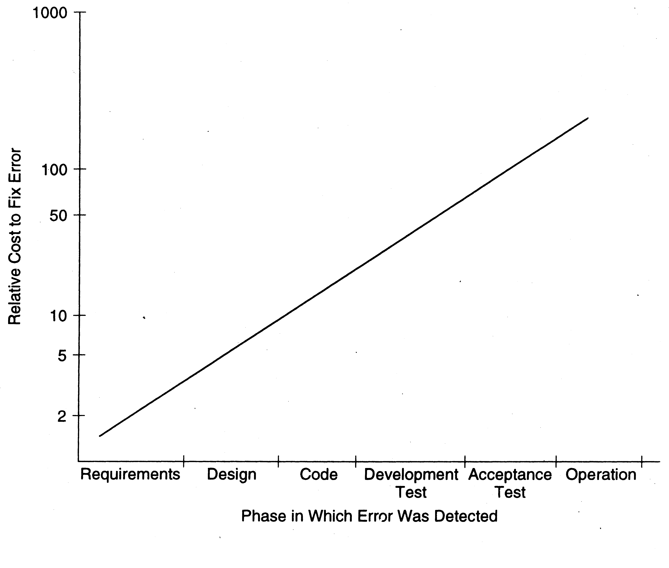
Early Defect Removal…
Sofware Process

Slide 12
Desired Properties…
Predictability and repeatability
  Process should repeat its performance when used on different projects
  I.e. outcome of using a process should be predictable
  Without predictability, cannot estimate, or say anything about quality or productivity
  With predictability, past performance can be used to predict future performance
Sofware Process

Slide 13
Predictability…
Predictable process is said to be under statistical control
  Repeatedly using the process produces similar results
  Results – properties of interest like quality, productivity, …
To consistently develop sw with high Q&P, process must be in control
Sofware Process

Slide 14
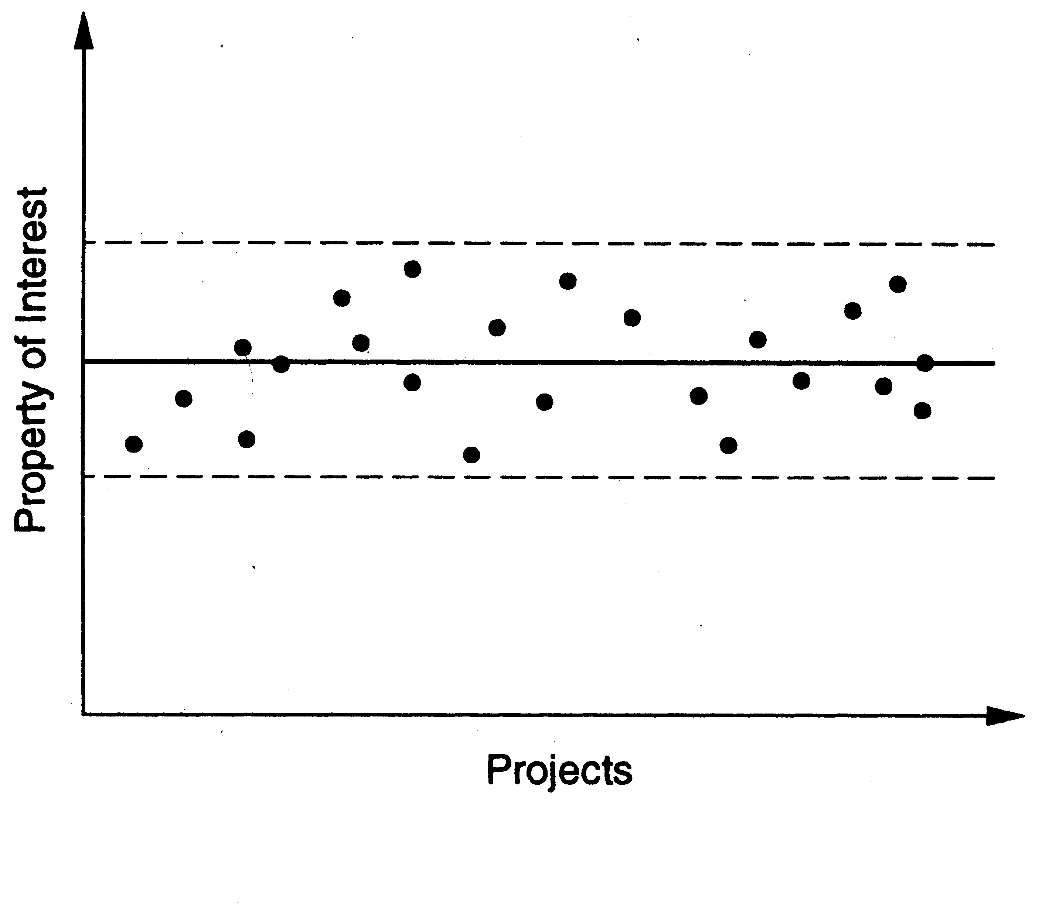
Predictability…
Sofware Process

Slide 15
Support Change
Software changes for various reasons
Requirements change is a key reason
Requirement changes cannot be wished away or treated as “bad”
They must be accommodated in the process for sw development
Sofware Process

Slide 16
Summary
Process – method for doing something
Process typically has stages, each stage focusing on an identifiable task
Stages have methodologies
Software process is the methods for developing software
Best to view it as comprising of multiple processes
Sofware Process

Slide 17
Summary
Goal is to produce software with high quality and productivity
Process is the means
Development process is central process
Mgmt process is for controlling dev
Other supporting processes
Sw process should have high Q&P, predictability, and support for change
Sofware Process

Slide 18
Development Process and Process Models
Sofware Process

Slide 19
Software Project
Project – to build a sw system within cost and schedule and with high quality which satisfies the customer
Project goals – high Q and high P
Suitable process needed to reach goals
For a project, the process to be followed is specified during planning
Sofware Process

Slide 20
Development Process
A set of phases and each phase being a sequence of steps
Sequence of steps for a phase - methodologies for that phase.
Why have phases
  To employ divide and conquer
  each phase handles a different part of the problem
  helps in continuous validation
Sofware Process

Slide 21
Development Process
Commonly has these activities: Requirements analysis, architecture, design, coding, testing, delivery
Different models perform them in different manner
Sofware Process

Slide 22
Requirement Analysis
To understand state the problem precisely
Forms the basis of agreement between user and developer
specifies “ what “ , not “ how “.
Not an easy task, as needs often understood.
Requirement specifications of even medium systems can be many hundreds of pages
Output is the sw req spec (SRS) document
Sofware Process

Slide 23
Design
A major step in moving from problem domain to solution domain; three main tasks
  Architecture design – components and connectors that should be there in the system
  High level design – modules and data structures needed to implement the architecture
  Detailed design – logic of modules
Most methodologies focus on architecture or high level design
Outputs are arch/des/logic design docs
Sofware Process

Slide 24
Coding
Converts design into code in specific language
Goal: Implement the design with simple and easy to understand code.
  Code should be simple and readable.
The coding phase affects both testing and maintenance. Well written code can reduce the testing and maintenance effort.
Output is code
Sofware Process

Slide 25
Testing
Defects are introduced in each phase
They have to be found and removed to achieve high quality
Testing plays this important role
Goal: Identify most of defects
Is a very expensive task; has to be properly planned and executed.
Outputs are Test plans/results, and the final tested (hopefully reliable) code
Sofware Process

Slide 26
Effort Distribution
Distribution of effort :
  Req. - 10-20%
  Design - 10-20%
  Coding - 20-30%
  Testing - 30-50%
Coding is not the most expensive.
Sofware Process

Slide 27
Distribution of effort…
How programmers spend their time
  Writing programs - 13%
  Reading programs and manuals - 16%
  Job communication - 32%
  Others - 39%
Programmers spend more time in reading programs than in writing them.
Writing programs is a small part of their lives.
Sofware Process

Slide 28
Defects
Distribution of error occurrences by phase is
  Req. - 20%
  Design - 30%
  Coding - 50%
Defects can be injected at any of the major phases.
Cost of latency: Cost of defect removal increases exponentially with latency time.
Sofware Process

Slide 29
Defects…
      Cost to fix
      Error ( log scale)
      Time
Cheapest way to detect and remove defects close to where it is injected.
Hence must check for defects after every phase.
Sofware Process

Slide 30
Process Models
A process model specifies a general process, usually as a set of stages
This model will be suitable for a class of projects
I.e. a model provides generic structure of the process that can be followed by some projects to achieve their goals
Sofware Process

Slide 31
Projects Process
If a project chooses a model, it will generally tailor it to suit the project
This produces the spec for the projects process
This process can then be followed in the project
I.e. process is what is actually executed; process spec is plan about what should be executed; process model is a generic process spec
Many models have been proposed for the development process
Sofware Process

Slide 32
Typical Student Process Model
Get problem stmt – Code – do some testing – deliver/demo
Why this process model cannot be used for commercial projects?
  Produces student-software, which is not what we are after
  Cannot ensure desired quality for industrial-strength software
Sofware Process

Slide 33
Common Process Models
Waterfall – the oldest and widely used
Prototyping
Iterative – currently used widely
Timeboxing
Sofware Process

Slide 34
Waterfall Model
Linear sequence of stages/phases
Requirements – HLD – DD – Code – Test – Deploy
A phase starts only when the previous has completed; no feedback
The phases partition the project, each addressing a separate concern
Sofware Process

Slide 35
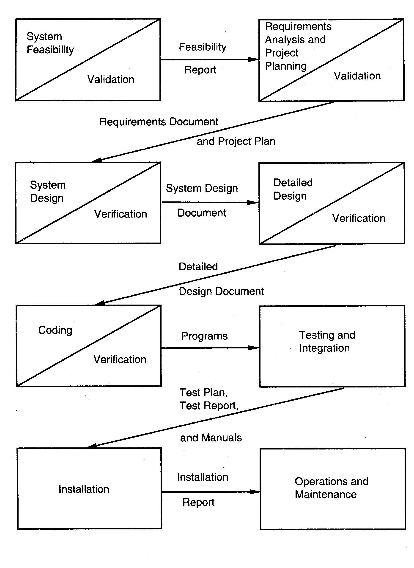
Sofware Process

Slide 36
Waterfall…
Linear ordering implies each phase should have some output
The output must be validated/certified
Outputs of earlier phases: work products
Common outputs of a waterfall: SRS, project plan, design docs, test plan and reports, final code, supporting docs
Sofware Process

Slide 37
Waterfall Advantages
Conceptually simple, cleanly divides the problem into distinct phases that can be performed independently
Natural approach for problem solving
Easy to administer in a contractual setup – each phase is a milestone
Sofware Process

Slide 38
Waterfall disadvantages
Assumes that requirements can be specified and frozen early
May fix hardware and other technologies too early
Follows the “big bang” approach – all or nothing delivery; too risky
Very document oriented, requiring docs at the end of each phase
Sofware Process

Slide 39
Waterfall Usage
Has been used widely
Well suited for projects where requirements can be understood easily and technology decisions are easy
I.e. for familiar type of projects it still may be the most optimum
Sofware Process

Slide 40
Prototyping
Prototyping addresses the requirement specification limitation of waterfall
Instead of freezing requirements only by discussions, a prototype is built to understand the requirements
Helps alleviate the requirements risk
A small waterfall model replaces the requirements stage
Sofware Process

Slide 41
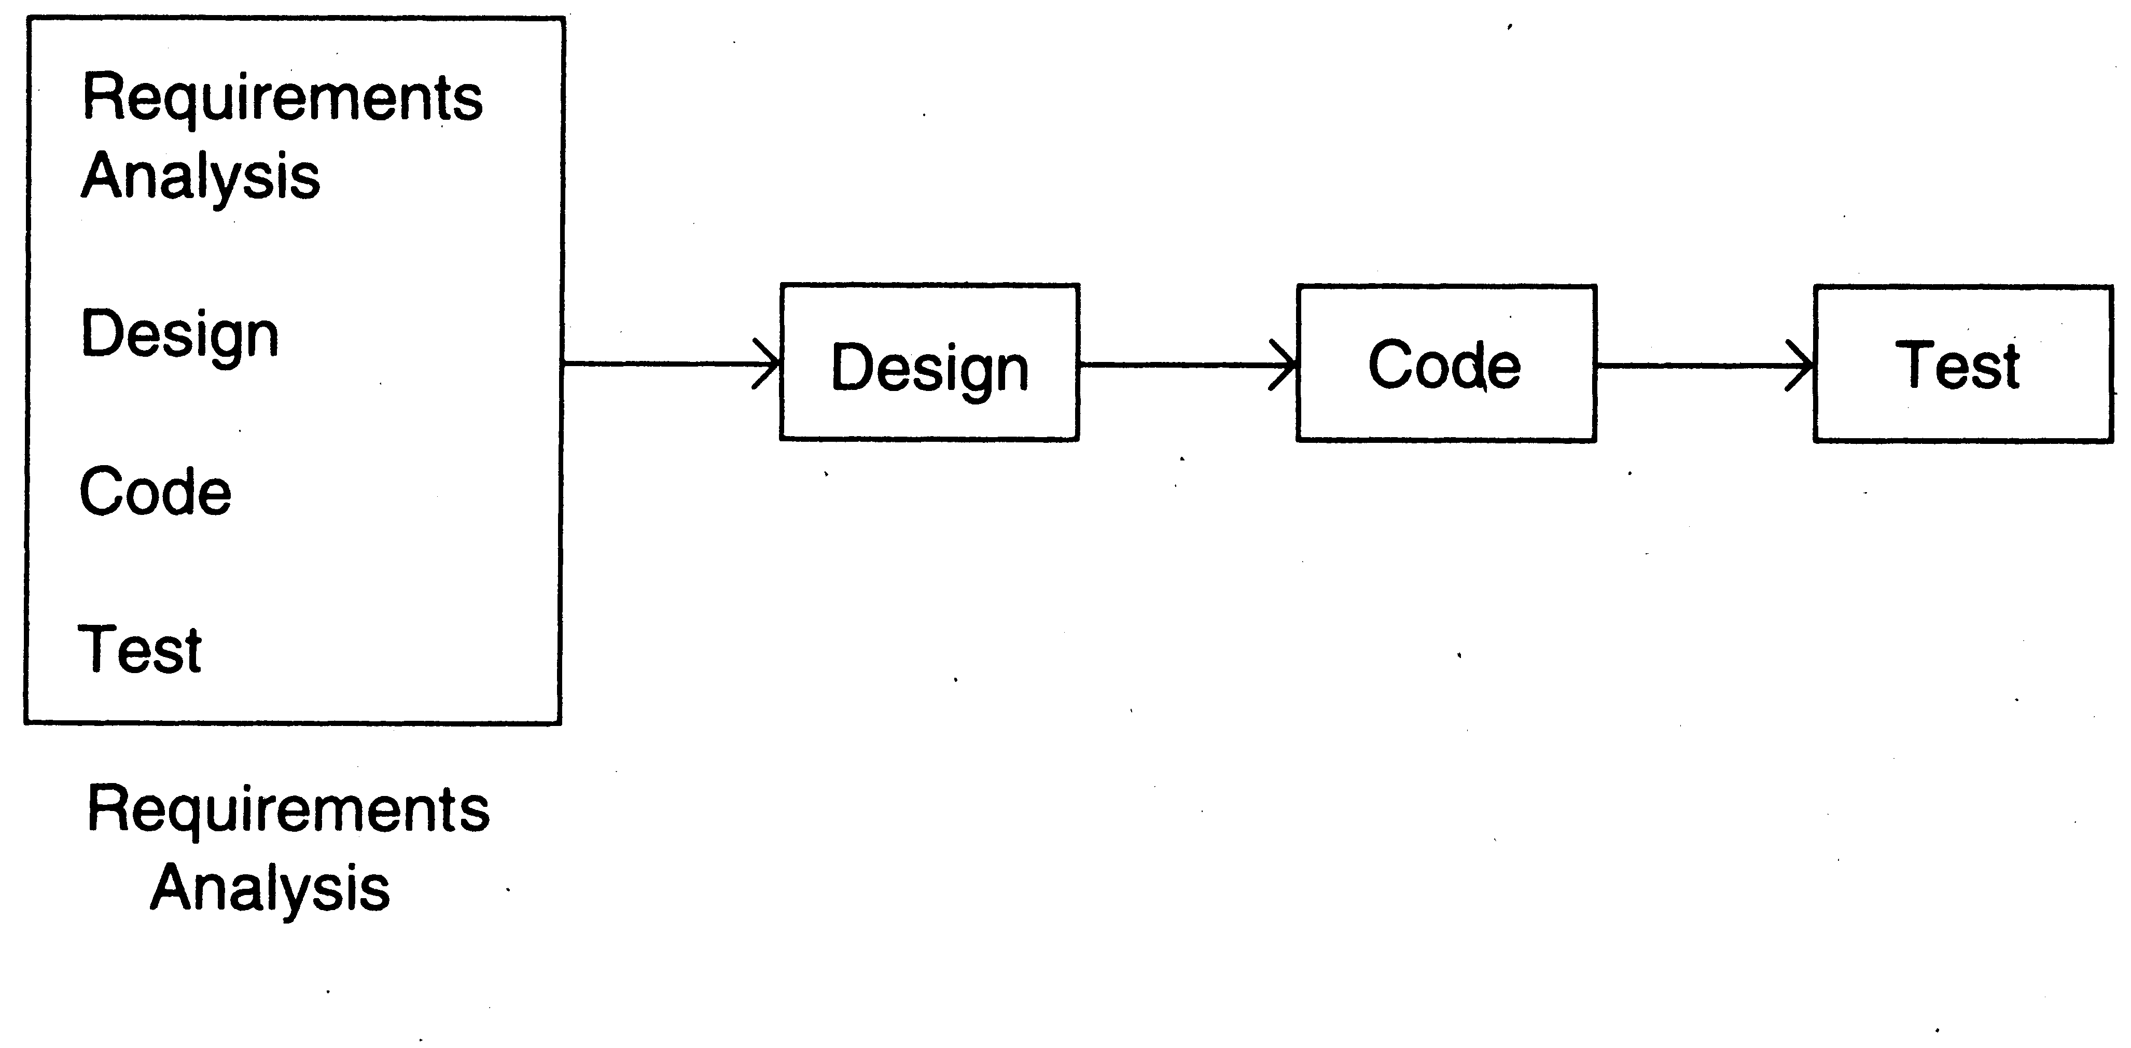
Prototyping
Sofware Process

Slide 42
Prototyping
Development of prototype
  Starts with initial requirements
  Only key features which need better understanding are included in prototype
  No point in including those features that are well understood
  Feedback from users taken to improve the understanding of the requirements
Sofware Process

Slide 43
Prototyping
Cost can be kept low
  Build only features needing clarification
  “quick and dirty” – quality not important, scripting etc can be used
  Things like exception handling, recovery, standards are omitted
  Cost can be a few % of the total
  Learning in prototype building will help in building, besides improved requirements
Sofware Process

Slide 44
Prototyping
Advantages: req will be more stable, req frozen later, experience helps in the main development
Disadvantages: Potential hit on cost and schedule
Applicability: When req are hard to elicit and confidence in reqs is low; i.e. where reqs are not well understood
Sofware Process

Slide 45
Iterative Development
Counters the “all or nothing” drawback of the waterfall model
Combines benefit of prototyping and waterfall
Develop and deliver software in increments
Each increment is complete in itself
Can be viewed as a sequence of waterfalls
Feedback from one iteration is used in the future iterations
Sofware Process

Slide 46
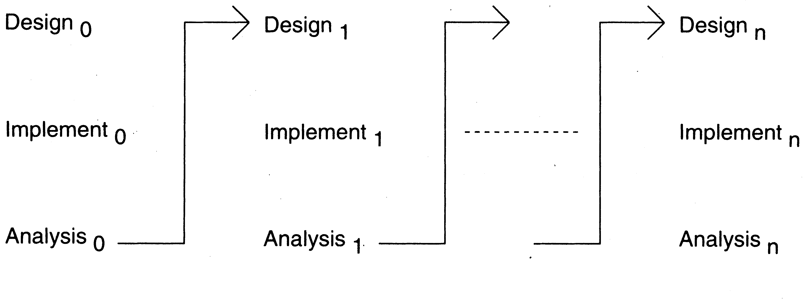
Iterative Enhancement
Sofware Process

Slide 47
Iterative Development
Products almost always follow it
Used commonly in customized development also
  Businesses want quick response for sw
  Cannot afford the risk of all-or-nothing
Newer approaches like XP, Agile,… all rely on iterative development
Sofware Process

Slide 48
Iterative Development
Benefits: Get-as-you-pay, feedback for improvement,
Drawbacks: Architecture/design may not be optimal, rework may increase, total cost may be more
Applicability: where response time is important, risk of long projects cannot be taken, all req not known
Sofware Process

Slide 49
Timeboxing
Iterative is linear sequence of iterations
Each iteration is a mini waterfall – decide the specs, then plan the iteration
Time boxing – fix an iteration duration, then determine the specs
Divide iteration in a few equal stages
Use pipelining concepts to execute iterations in parallel
Sofware Process

Slide 50
Time Boxed Iterations
General iterative development – fix the functionality for each iteration, then plan and execute it
In time boxed iterations – fix the duration of iteration and adjust the functionality to fit it
Completion time is fixed, the functionality to be delivered is flexible
Sofware Process

Slide 51
Time boxed Iteration
This itself very useful in many situations
Has predictable delivery times
Overall product release and marketing can be better planned
Makes time a non-negotiable parameter and helps focus attention on schedule
Prevents requirements bloating
Overall dev time is still unchanged
Sofware Process

Slide 52
Timeboxing – Taking Time Boxed Iterations Further
What if we have multiple iterations executing in parallel
Can reduce the average completion time by exploiting parallelism
For parallel execution, can borrow pipelining concepts from hardware
This leads to Timeboxing Process Model
Sofware Process

Slide 53
Timeboxing Model – Basics
Development is done iteratively in fixed duration time boxes
Each time box divided in fixed stages
Each stage performs a clearly defined task that can be done independently
Each stage approximately equal in duration
There is a dedicated team for each stage
When one stage team finishes, it hands over the project to the next team
Sofware Process

Slide 54
Timeboxing
With this type of time boxes, can use pipelining to reduce cycle time
Like hardware pipelining – view each iteration as an instruction
As stages have dedicated teams, simultaneous execution of different iterations is possible
Sofware Process

Slide 55
Example
An iteration with three stages – Analysis, Build, Deploy
  These stages are appx equal in many situations
  Can adjust durations by determining the boudaries suitably
  Can adjust duration by adjusting the team size for each stage
Have separate teams for A, B, and D
Sofware Process

Slide 56
Pipelined Execution
AT starts executing it-1
AT finishes, hands over it-1 to BT, starts executing it-2
AT finishes it-2, hands over to BT; BT finishes it-1, hands over to DT; AT starts it-3, BT starts it-2 (and DT, it-1)
…
Sofware Process

Slide 57
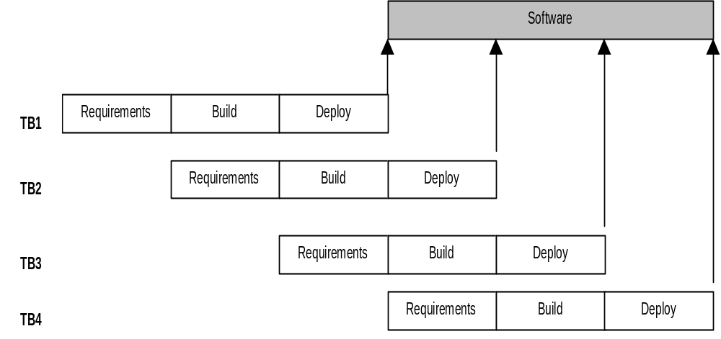
Timeboxing Execution
Sofware Process

Slide 58
Timeboxing execution
First iteration finishes at time T
Second finishes at T+T/3; third at T+2 T/3, and so on
In steady state, delivery every T/3 time
If T is 3 weeks, first delivery after 3 wks, 2nd after 4 wks, 3rd after 5 wks,…
In linear execution, delivery times will be 3 wks, 6 wks, 9 wks,…
Sofware Process

Slide 59
Timeboxing execution
Duration of each iteration still the same
Total work done in a time box is also the same
Productivity of a time box is same
Yet, average cycle time or delivery time has reduced to a third
Sofware Process

Slide 60
Team Size
In linear execution of iterations, the same team performs all stages
If each stage has a team of S, in linear execution the team size is S
In pipelined execution, the team size is three times (one for each stage)
I.e. the total team size in timeboxing is larger; and this reduces cycle time
Sofware Process

Slide 61
Team Size
Merely by increasing the team size we cannot reduce cycle time - Brook’s law
Timeboxing allows structured way to add manpower to reduce cycle time
Note that we cannot change the time of an iteration – Brook’s law still holds
Work allocation different to allow larger team to function properly
Sofware Process

Slide 62
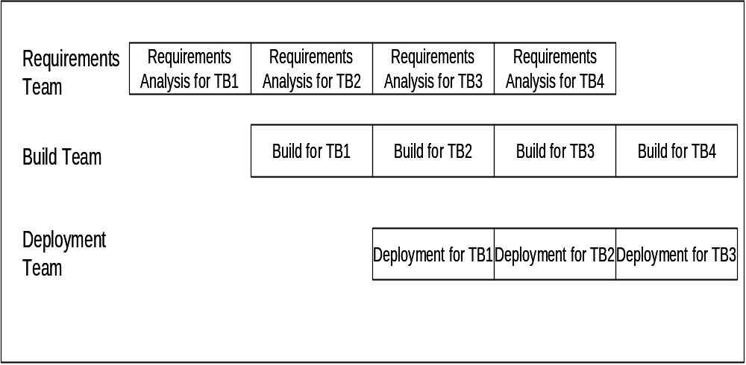
Work Allocation of Teams
Sofware Process

Slide 63
Timeboxing
Advantages: Shortened delivery times, other adv of iterative, distr. execution
Disadvantages: Larger teams, proj mgmt is harder, high synchronization needed, CM is harder
Applicability: When short delivery times v. imp.; architecture is stable; flexibility in feature grouping
Sofware Process

Slide 64
Summary
Process is a means to achieve project objectives of high QP
Process models define generic process, which can form basis of project process
Process typically has stages, each stage focusing on an identifiable task
Many models for development process have been proposed
Sofware Process

Slide 65
Summary – waterfall
Strength | Weakness | Types of Projects
Simple Easy to execute Intuitive and logical Easy contractually | All or nothing – too risky Req frozen early May chose outdated hardware/tech Disallows changes No feedback from users Encourages req bloating | Well understood problems, short duration projects, automation of existing manual systems
Sofware Process

Slide 66
Summary – Prototyping
Strength | Weakness | Types of Projects
Helps req elicitation Reduces risk Better and more stable final system | Front heavy Possibly higher cost and schedule Encourages req bloating Disallows later change | Systems with novice users; or areas with req uncertainity. Heavy reporting based systems can benefit from UI proto
Sofware Process

Slide 67
Summary – Iterative
Strength | Weakness | Types of Projects
Regular deliveries, leading to biz benefit Can accommodate changes naturally Allows user feedback Avoids req bloating Naturally prioritizes req Allows reasonable exit points Reduces risks | Overhead of planning each iteration Total cost may increase System arch and design may suffer Rework may increase | For businesses where time is imp; risk of long projects cannot be taken; req not known and evolve with time
Sofware Process

Slide 68
Summary – Timeboxing
Strength | Weakness | Types of Projects
All benefits of iterative Planning for iterations somewhat easier Very short delivery times | PM becomes more complex Team size is larger Complicated – lapses can lead to losses | Where very short delivery times are very important Where flexibility in grouping features Arch is stable
Sofware Process

Slide 69
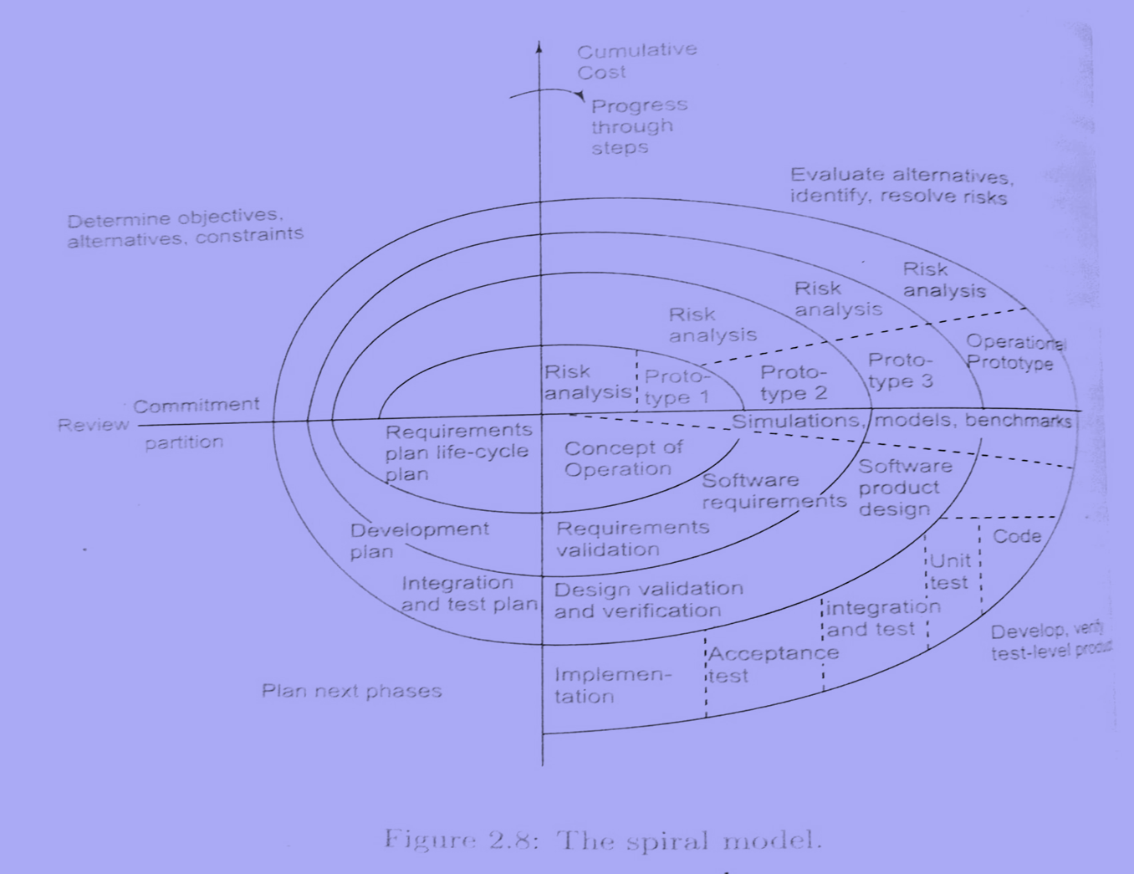
Sofware Process

Slide 70
Spiral Model
Each cycle begins with the identification of:
  Objectives for that cycle
  Different possible alternatives for achieving them
  Constraints that exist
Sofware Process

Slide 71
Spiral Model
Next step is evaluation:
  Evaluate the different alternatives based on objectives and subject to constraints
  Evaluation is based on risk perception for the project
Sofware Process

Slide 72
Spiral Model
Next step is development of strategies:
  To resolve the uncertainties and risk
  May involve activities such as benchmarking, simulation and prototyping
In the next step software is developed keeping in mind the risks
Finally, the next stage is planned.
Sofware Process

Slide 73
Agile Software Development Framework
Agile is a type of software development methodology that anticipates the need for flexibility and applies a level of pragmatism to the delivery of the finished product.
focuses on the clean delivery of individual pieces or parts of the software and not on the entire application.
Sofware Process

Slide 74
Agile Manifesto
In 2001, 17 software development professionals gathered to discuss concepts around the idea of lightweight software development and ended up creating the Agile Manifesto.
The Manifesto outlines the four core values of Agile
Sofware Process

Slide 75
The four values of Agile
Individual interactions are more important than processes and tools
A focus on working software rather than thorough documentation
Collaboration instead of contract negotiations
A focus on responding to change
Sofware Process

Slide 76
The 12 principles of Agile
Satisfy customers through early and continuous delivery of valuable work.
Break big work down into smaller tasks that can be completed quickly.
Recognize that the best work emerges from self-organized teams.
Provide motivated individuals with the environment and support they need and trust them to get the job done.
Create processes that promote sustainable efforts.
Maintain a constant pace for completed work.
Sofware Process

Slide 77
The 12 principles of Agile
Welcome changing requirements, even late in a project.
Assemble the project team and business owners on a daily basis throughout the project.
Have the team reflect at regular intervals on how to become more effective, then tune and adjust behavior accordingly.
Measure progress by the amount of completed work.
Continually seek excellence.
Harness change for a competitive advantage.
Sofware Process

Slide 78
The Agile software development cycle
concept
inception
iteration/construction
release
production
retirement
Sofware Process

Slide 79
Source:
https://www.techtarget.com/searchsoftwarequality/definition/agile-software-development
https://en.wikipedia.org/wiki/Agile_software_development
Sofware Process

